Slide 1

Solar Energy Production Forecast
Three-hourly forecast Île-de-France
Team Solar Power (Yijun ZHU, Raphaël ADAMCZYK, Hani CHERID)

Slide 2
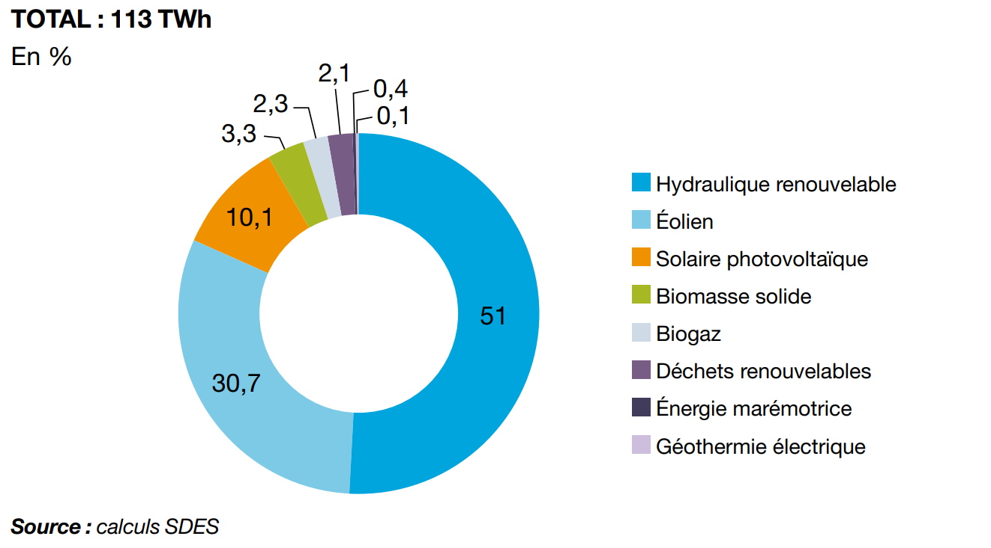
Overview
Steadily growing for several years, renewable energy now represents more than 21% of total electricity production in 2019 in France.
As an important part of renewable energy, solar PV represents 10.1% of gross renewable electricity generation.
Gross renewable electricity production by Sector in 2019

Slide 3
Project framework
Project definition
Data mining and processing
Data exploration
Data modeling
Evaluation and prediction
1
2
3
4
5

Slide 4
Challenges
With the advantage of being cleaner than traditional energy sources, renewable energies come with multiples challenges:
Difficult to store. Batteries and other storage capacities are not mature enough technologically speaking. The power is handled smartly over “grids” that would redirect supply where the demand lies on the network.
Overproduction results in loss of money.
Renewable energies like solar and wind energy are directly dependent on the weather which is dynamic and complex to forecast.
Underproduction results in inconvenience for clients, a fine from the government and impact on provider reputation.
This calls for an accurate forecast and management of energy production based on external conditions.

Slide 5
Project Objectives
Apply different models (Time Series, Machine Learning & Deep Learning) to 2017-2020 Solar Energy Production Data combined with Weather and Solar radiation Data in Île-de-France region and choose the best one in order to forecast production of solar energy with a lead time of 3 hours to 1 week.

Slide 6
Project framework
Project definition
Data mining and processing
Data exploration
Data modeling
Evaluation and prediction
1
2
3
4
5

Slide 7
Data Collection
Datasets | Time step | Time range | Location / region | Key features
Solar Energy Production | Half-hourly | 2017-01-01 to 2020-12-31 | Île-de-France | Solaire (MW)
Solar Radiance | Three-hourly |  | Île-de-France | Rayonnement solaire global (W/m²) Vitesse du vent à 100m (m/s)
Weather | Hourly |  | Station Paris Montsouris | Air temperature (10*°C) Precipitation per hour (10*mm) Station pressure rate (10*hPa) ...
Source: Commission de régulation de l'énergie (CRE) Open Data, National Centers for Environmental Information
Notes:
After reading some existing research papers on energy production or consumption prediction, we have pre-defined some important features to include for our project.
We collected 3 data sets in the end

Slide 8
Preprocessing of datasets
The datasets coming from different sources, their format need to be cleaned and standardized:
Understanding and selection of variables
Data type assignment (date, integer,...)
Substitution of missing values (e.g. replace with average of the 2 rows before and after)
Removal of useless or redundant information based on correlation analysis (e.g. sea level pressure & station pressure)
Concatenation of all datasets into one with a three-hourly frequency (resample, adjust datetime index)
Notes:
For each of the dataset, we have performed some data cleaning and processing, including:
E.g. in the raw weather dataset, every column is represented with a specific code so we have to refer to a 100 page documentation to understand each field
Also in the weather dataset, one column represents one field and contains 4 to 5 information related to that field. One field may be wind speed, air temperature etc.
...

Slide 9
Concatenated dataset shape
Response variable : Solar power production (MW)
Covariates :
Temperature of the air (°C)
Hourly precipitation depth (mm)
Station air pressure(Pa)
Wind speed at 100m altitude (m/s)
Global Solar radiation (W/m2)
Time frame : 1st January 2017 01:00AM to 31st December 2020 10:00PM
11688 records
Notes:
So in the end we merge all three datasets together and get a dataframe containing:
The # of data records also allows us to apply some deep learning models

Slide 10
Project framework
Project definition
Data mining and processing
Data exploration
Data modeling
Evaluation and prediction
1
2
3
4
5

Slide 11

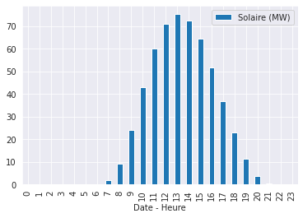
Data exploration
Key observations
Daily seasonality
The production of solar energy reaches the peak at 13h
Negligible from 22:00 to 06:00 corresponding to night time
Notes:
Corresponds to normal sense

Slide 12
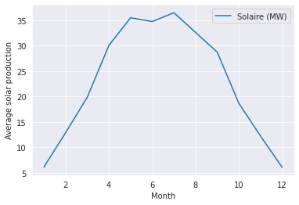
Data exploration
Monthly seasonality
The production of solar energy in Ile-de-France region is:
the highest from May to July (spring to summer season)
the lowest from November to February (winter season)

Slide 13
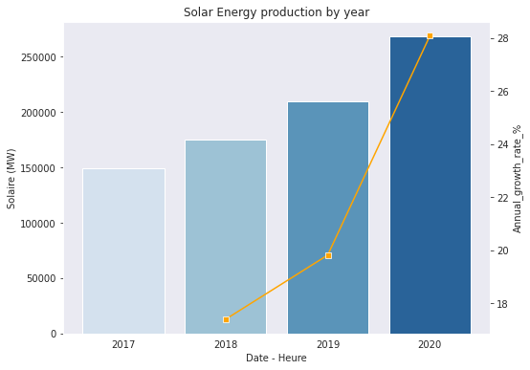
Data exploration
Yearly evolution
28%
Annual growth rate (%)
From 2017 to 2020, the production of solar energy grows at an increasing rate
20%
17%

Slide 14
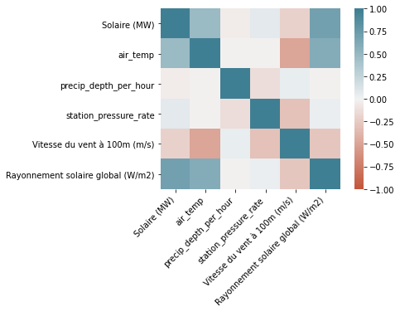
Data exploration
Pearson correlation between initial features
From the graph we observe a clear and strong correlation between solar radiation and the production of solar energy. A weaker correlation with air temperature can be identified.
There is no strong correlation between the features other than solar energy observed.

Slide 15
Project framework
Project definition
Data mining and processing
Data exploration
Data modeling
Evaluation and prediction
1
2
3
4
5

Slide 16
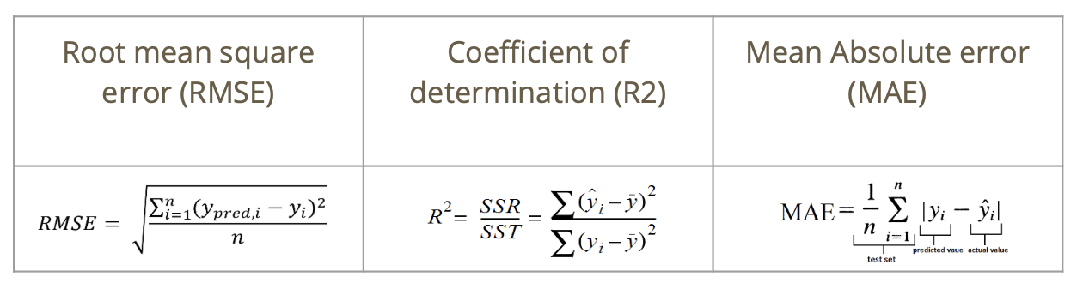
Data modeling
Multiple models were considered for the project using:
Time series analysis
Machine Learning techniques
Deep Learning techniques
The metrics used to compare those models were :

Slide 17
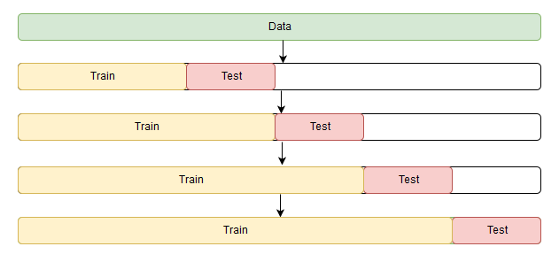
Data modeling - Time series cross validation
Cross-validation for time series is a bit different because time series have a temporal structure and one cannot randomly mix values in a fold while preserving this structure.
So we used a method of "cross-validation on a rolling basis" which can be established using the sklearn.model_selection's TimeSeriesSplit module.
Source: mlcourse.ai
Notes:
The idea is rather simple -- we train our model on a small segment of the time series from the beginning until some timepoint , make predictions for the next steps, and calculate an error. Then, we expand our training sample to value, make predictions from until , and continue moving our test segment of the time series until we hit the last available observation. As a result, we have as many folds as will fit between the initial training sample and the last observation.

Slide 18
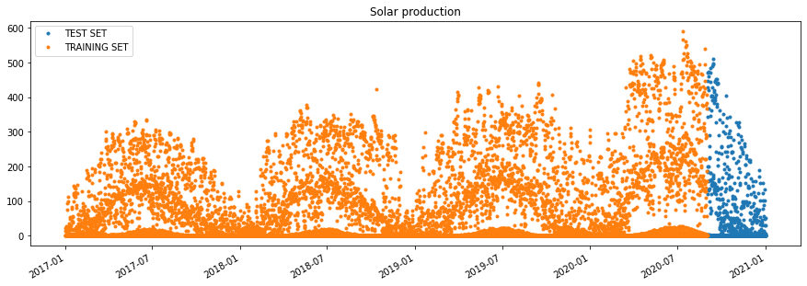
Data modeling - Train/test split
Split_date = ‘2020-09-01’
Taking into consideration the final forecast period limited to one week due to weather forecast accuracy, we mainly look at 1 week forecast performance of the test set
But we also look at the forecast on the whole test set for a more general performance of the model

Slide 19
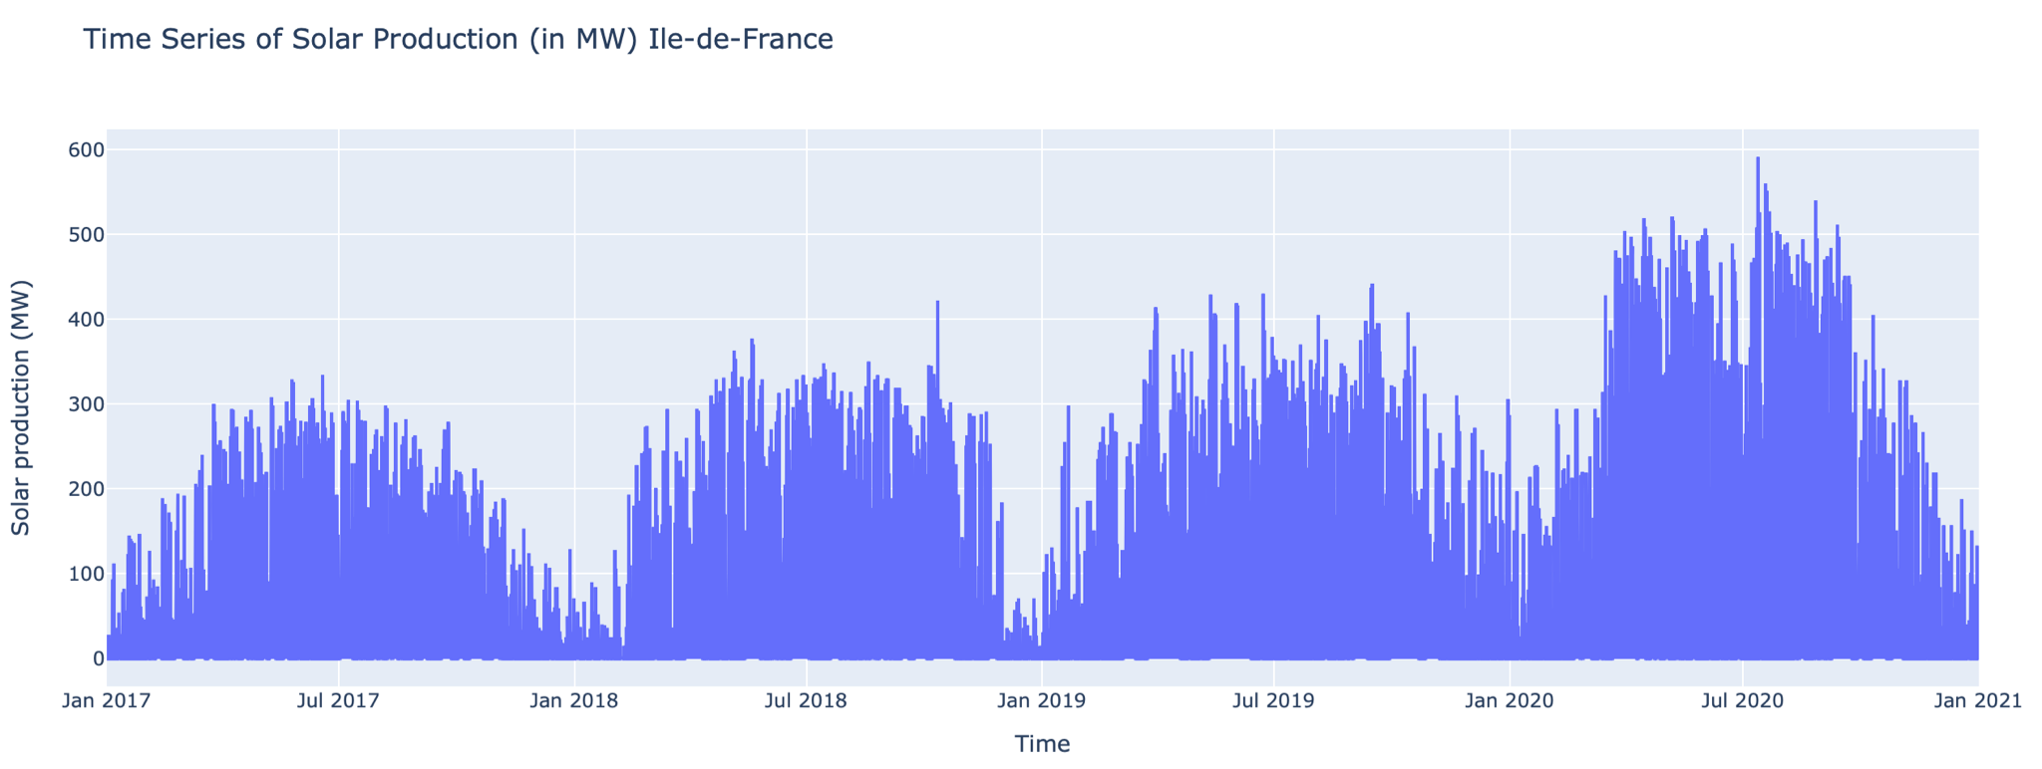
Data modeling - Time series analysis
Main difficulty : Handling multiple seasonalities and trend pattern
Notes:
So the first family of models: Time Series
We have learned TS models in class especially ARIMA, SARIMA models
So we have to apply some tricks in order to apply SARIMA method

Slide 20
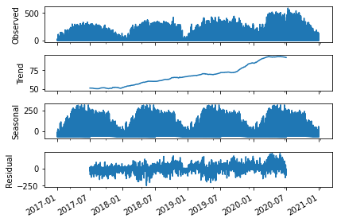
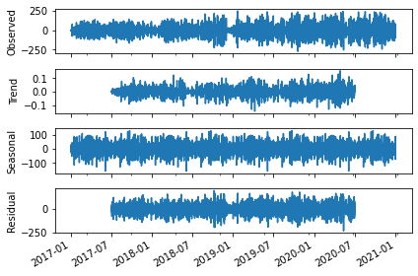
Data modeling - Time series analysis
Prior to consider a model, the series stationarity have to be evaluated. We start by decomposing the series and remove trend pattern by differentiation.

Slide 21
Data modeling - Time series analysis
Method used to evaluate the stationarity of the series : Dicky Fuller test and KPSS
DF test outcome on original series => seems stationary (p-value 2.75 * 10^(-5))
KPSS test outcome on original series => not stationary (p-value 0.01)
DF test outcome on differentiated series => seems stationary
KPSS test outcome on differentiated series => seems stationary
Conclusion: 1st order differentiated series will be used to fit the SARIMAX model
Notes:
This helps us to define the initial differentiation term for the SARIMAX model

Slide 22
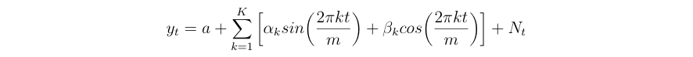
Data modeling - Time series analysis
The 1st model considered to deal with multiple seasonality : SARIMAX with Fourier series
Reason : Usual SARIMA models are not fit for multiple seasonality
Advantages of the SARIMAX with Fourier series approach :
Flexibility of seasonality length
Data with multiples seasonal periods can be model with Fourier terms of different frequencies
Short-term dynamics are easily handled with a simple ARMA error
with Nt an ARIMA model, m the seasonal period and K a hyperparameter to tune

Slide 23
Time series analysis - SARIMAX with Fourier series
For yearly seasonality, period considered => m = 365.25 (including the leap year)
For daily seasonality, period considered => m = 24
After transformation of training dataset into Fourier series, the best model fitted with auto arima function : SARIMAX (3,1,2)(1,0,1) (AIC criterion = 103743.527)

Slide 24
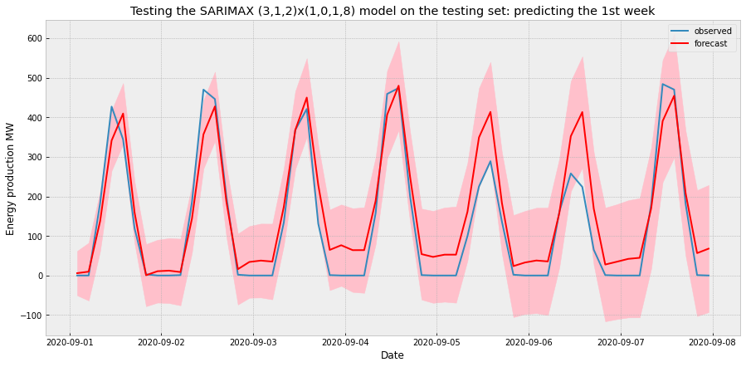
Time series analysis - SARIMAX with Fourier series
Results obtained for a one week forecasting
Error | Value
RMSE | 60
R2 | 0.87
MAE | 47.6

Slide 25
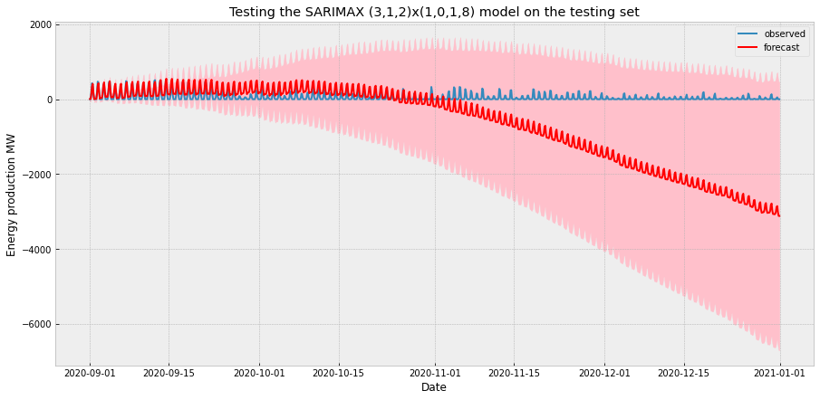
Time series analysis - SARIMAX with Fourier series
Trial for forecasting four months

Slide 26
Time series analysis - SARIMAX with Fourier series
The model seems to be performing relatively well for a one week forecasting but there is still a margin for improvement
The 4 months forecasting trial shows a sharp decline in performance with negative value for energy production from November onwards which is aberrant

Slide 27
Data modeling - Time series analysis
The 2nd model considered to deal with multiple seasonality : FBProphet
Developed by Facebook
Based on an additive model where non-linear trends are fit with yearly, weekly, and daily seasonality, plus holiday effects.

Slide 28
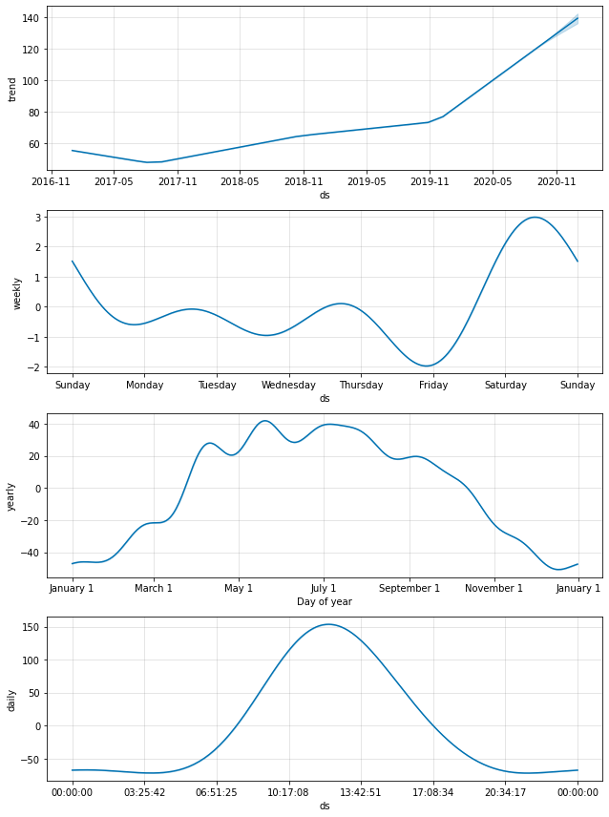
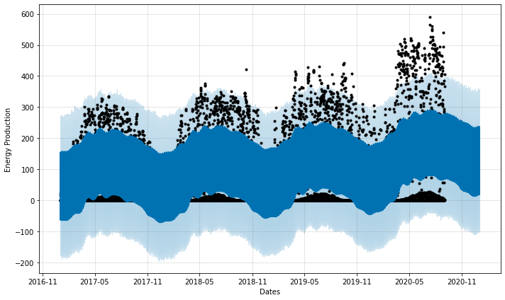
Time series analysis - FB Prophet
Results obtained with uncertainty level set at 95% (default 80%)
Notes:
Overall, the multiples seasonalities have been properly captured by the model
However, the forecasted values are not so satisfying and can be improved
Cross-validation on the training set and a reduction of the forecasting period were considered to try improving the model

Slide 29
Time series analysis - FB Prophet
Overall, the multiples seasonalities have been properly captured by the model
However, the forecasted values are not so satisfying and can be improved
Cross-validation on the training set and a reduction of the forecasting period were considered to try improving the model

Slide 30
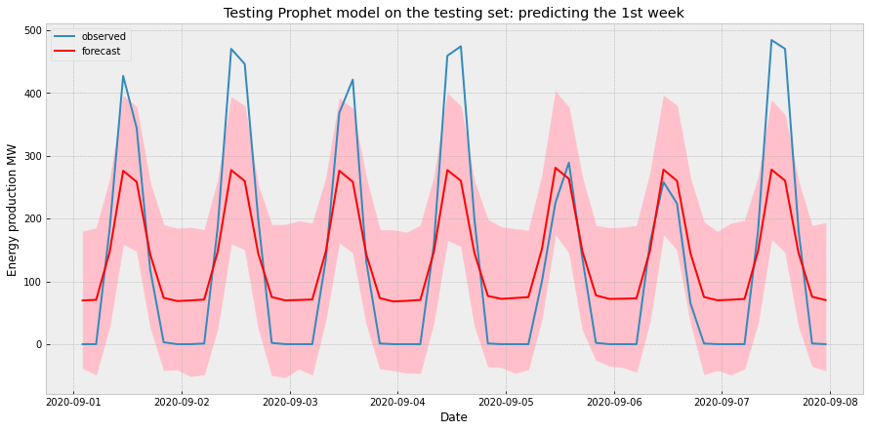
Time series analysis - FB Prophet
Error | Value
RMSE | 60.43
R2 | 0.70
MAE | 47.27

Slide 31
Data modeling - Machine learning techniques
To furtherly push the modeling step, various machine learning models were considered:
Lasso regression
Elastic Net regression
Random Forest regression
Extreme Gradient Boosting (XGBoost)

Slide 32
Data modeling - Feature extraction for date/time
We have considered 2 different sets of date time features:
Full hot encoded variables for year (year_2017, …, year_2020), month (month_1, …, month_12) and hour (hour1, …, hour24).
Reduced feature space: keeping year as numerical values, reduce months into 4 seasons and reduce hours into 4 time_of_the_day (morning, afternoon, evening, night)

Slide 33
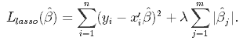
Data modeling - Lasso regression
Lasso adds a penalty for non-zero coefficients. Lasso penalizes the sum of the absolute values of the coefficients (L1 penalty). As a result, for high values of λ, many coefficients are exactly zeroed under lasso, which allows for automated feature selection.
Lasso tends to do well if there are a small number of significant parameters and the others are close to zero.
Notes:
So first we implemented Lasso Regression on our dataset with the covariates

Slide 34
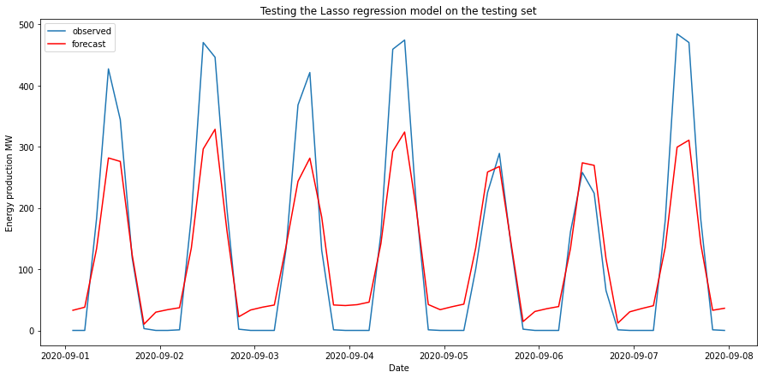
Lasso regression using full hot-encoded variables
Results obtained for a one week forecasting
Error | Value
RMSE | 69.5
R2 | 0.82
MAE | 52.0

Slide 35
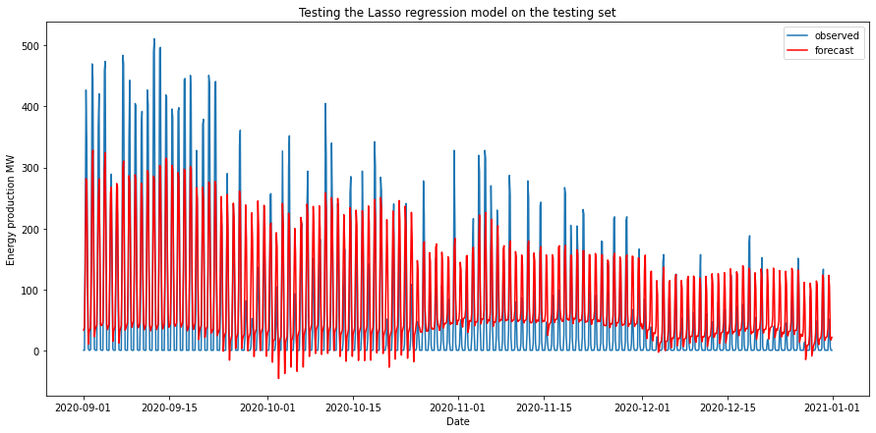
Lasso regression using full hot-encoded variables
Trial for forecasting four months

Slide 36
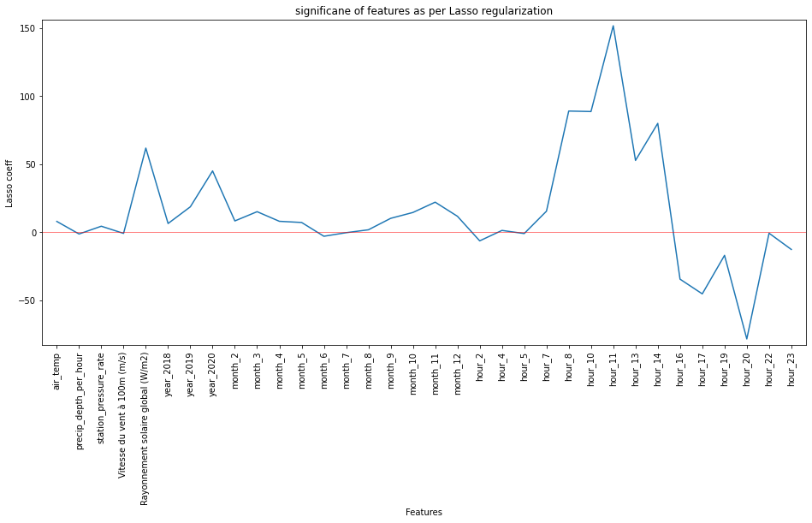
Data modeling - Lasso regression
Hot encoded variables have been used like hour_1, hour_2,..., month_2, month_3,.. etc.
Loss of information as the model assumes that the 23rd hour is far away from the 0th hour (and same for months) which is not the case because of the periodicity of the time series.
To avoid the loss of information and to lower the number of predictor variables we considered feature engineering on the covariates space.

Slide 37
Lasso regression in reduced feature space
Introduction of a season feature capturing month/hour specificity (winter/summer…, night/morning…) for space reduction
The results obtained are not really improved in this framework
Error | Value
RMSE | 83.2
R2 | 0.74
MAE | 60.6

Slide 38
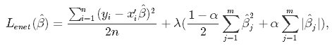
Data modeling - Elastic Net regression
Elastic Net first emerged as a result of critique on lasso, whose variable selection can be too dependent on data and thus unstable. The solution is to combine the penalties of ridge regression and lasso to get the best of both worlds. Elastic Net aims at minimizing the following loss function:
where α is the mixing parameter between ridge (α = 0) and lasso (α = 1).
We used Grid Search for best parameters alpha and l1_ratio: l1_ratio = 1

Slide 39
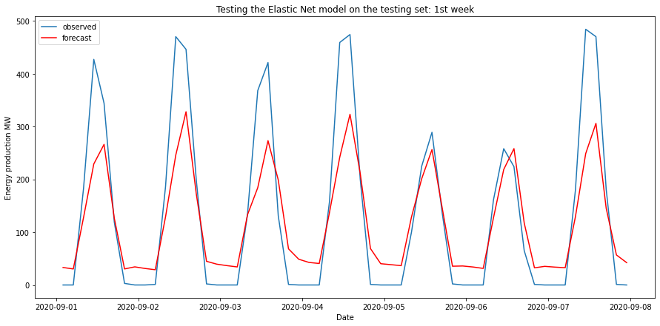
Data modeling - Elastic Net regression
Results obtained for a one week forecasting
Error | Value
RMSE | 83.18
R2 | 0.74
MAE | 60.6

Slide 40
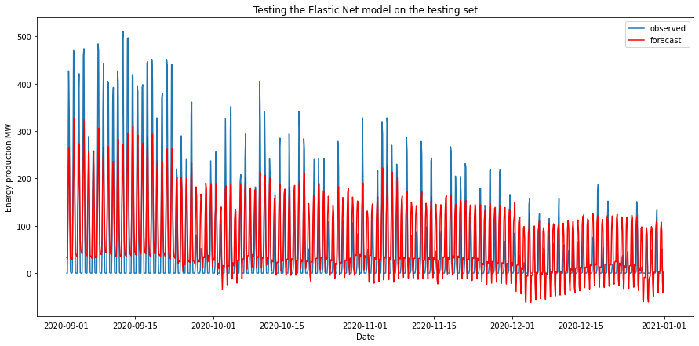
Data modeling - Elastic Net regression
Trial for forecasting four months

Slide 41
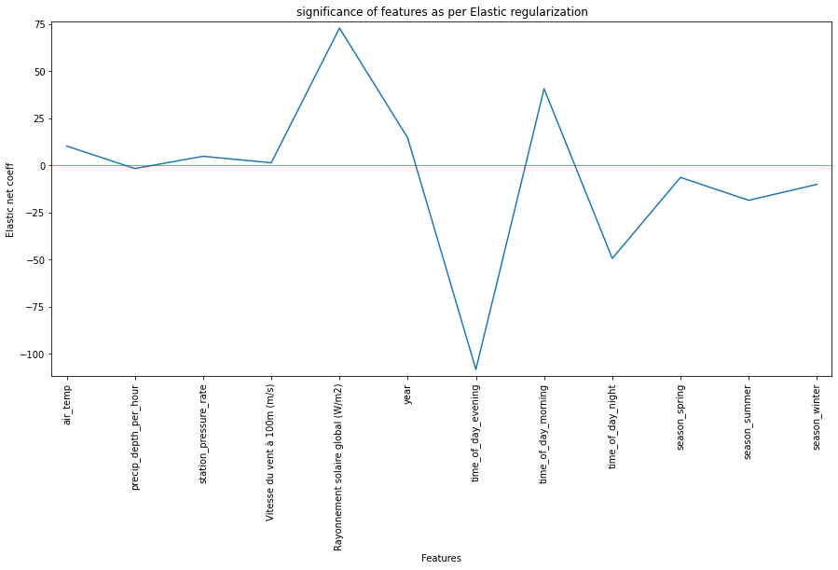
Data modeling - Elastic Net regression

Slide 42
Data modeling - Random Forest regression
Usually the Random forest doesn't perform very well on a time series problem and most often than not it will overfit the data and predict poorly on the test set. But the performance of random forest on a time series problem can be improved by some feature engineering.
We fit random forest on the reduced feature space and used RandomizedSearchCV for best parameters
{'max_depth': 5, 'max_features': 'auto', 'n_estimators': 73}
Notes:
We have seen some comments that RF doesn’t work well with TS, however we still see popular application for energy production prediction
The performance can usually be improved by limiting the number of features, and that’s also one of the season we prefer to use the reduced feature space

Slide 43
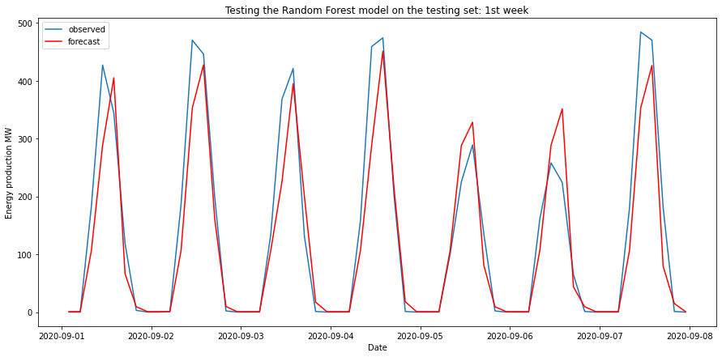
Data modeling - Random Forest regression
Results obtained for a one week forecasting
Error | Value
RMSE | 56.3
R2 | 0.88
MAE | 34.7

Slide 44
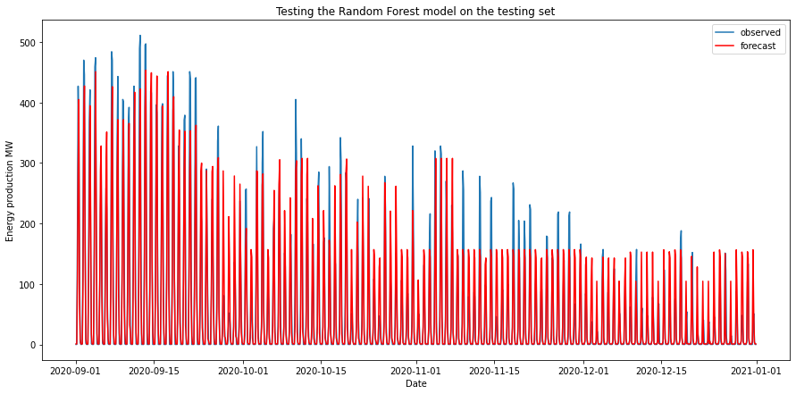
Data modeling - Random Forest regression
Trial for forecasting four months
The results have improved quite a lot compared to linear regressions
But we must be aware of the limitation of extrapolation of Random Forest

Slide 45
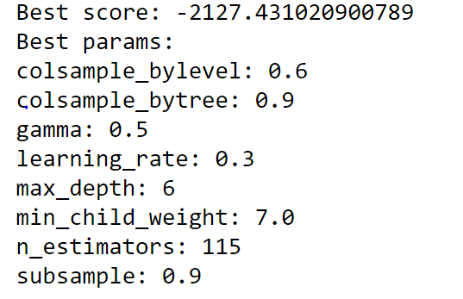
Data modeling - XGBoost
XGBoost (Extreme Gradient Boosting) belongs to a family of boosting algorithms and uses the gradient boosting (GBM) framework at its core. It is an optimized distributed gradient boosting library.
We fit XGBoost on the reduced feature space and used RandomizedSearchCV for best parameters
Notes:
Which is widely used for kaggle competitions and generate good results

Slide 46
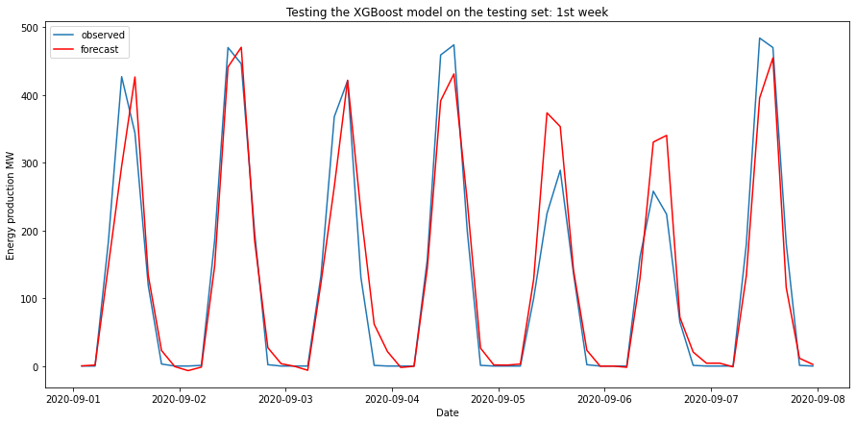
Data modeling - XGBoost
Results obtained for a one week forecasting
Error | Value
RMSE | 47.3
R2 | 0.92
MAE | 30.1

Slide 47
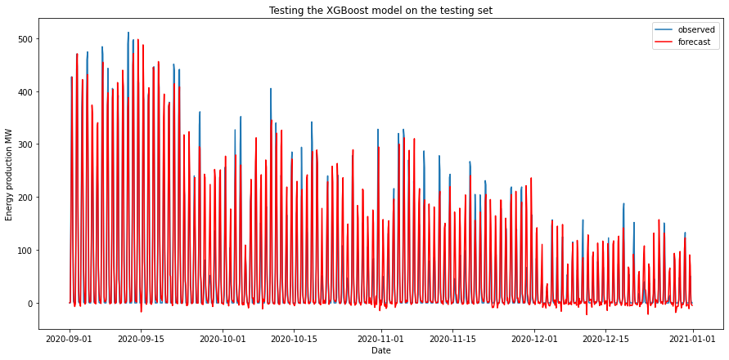
Data modeling - XGBoost
Results obtained for 4 month forecasting
Same limitation of extrapolation as of Random Forest

Slide 48
Data modeling - Deep learning techniques
Deep learning techniques were also considered to model the problem :
Artificial Neural Network (ANN)
Long Short Term Memory (LSTM)
Convolutional Neural Network (CNN) + Long Short Term Memory

Slide 49
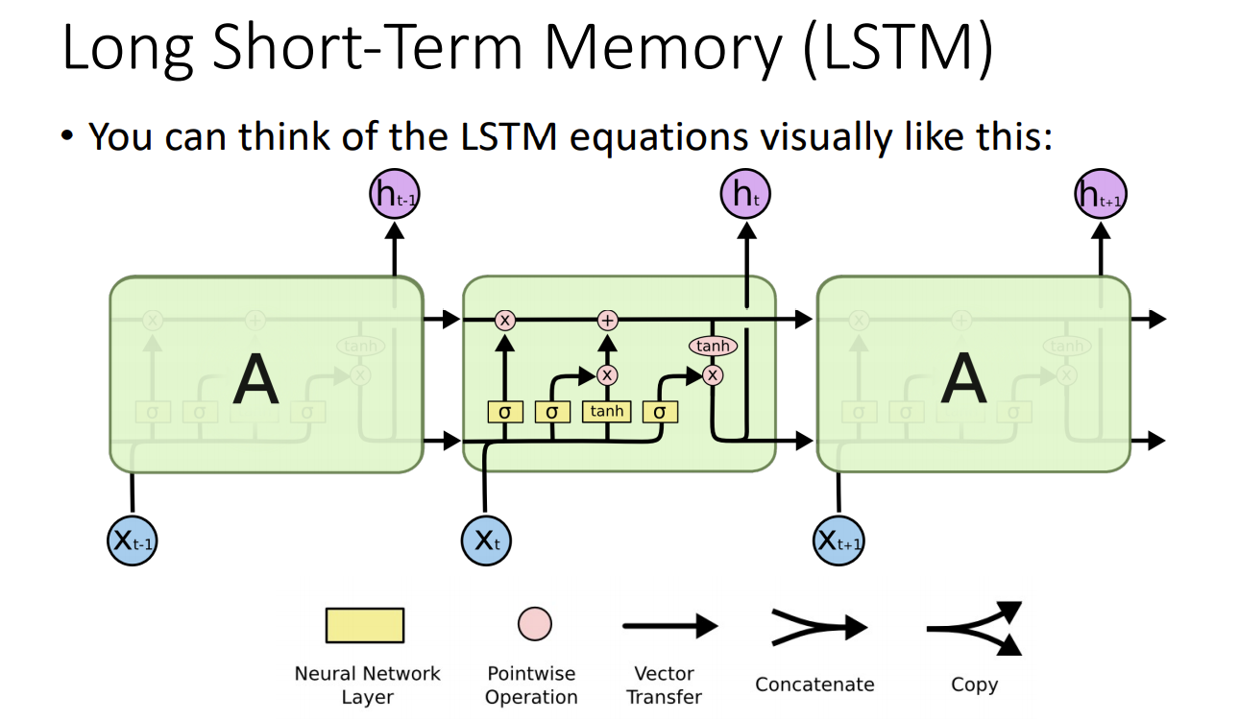
Data modeling - Deep learning techniques

Slide 50
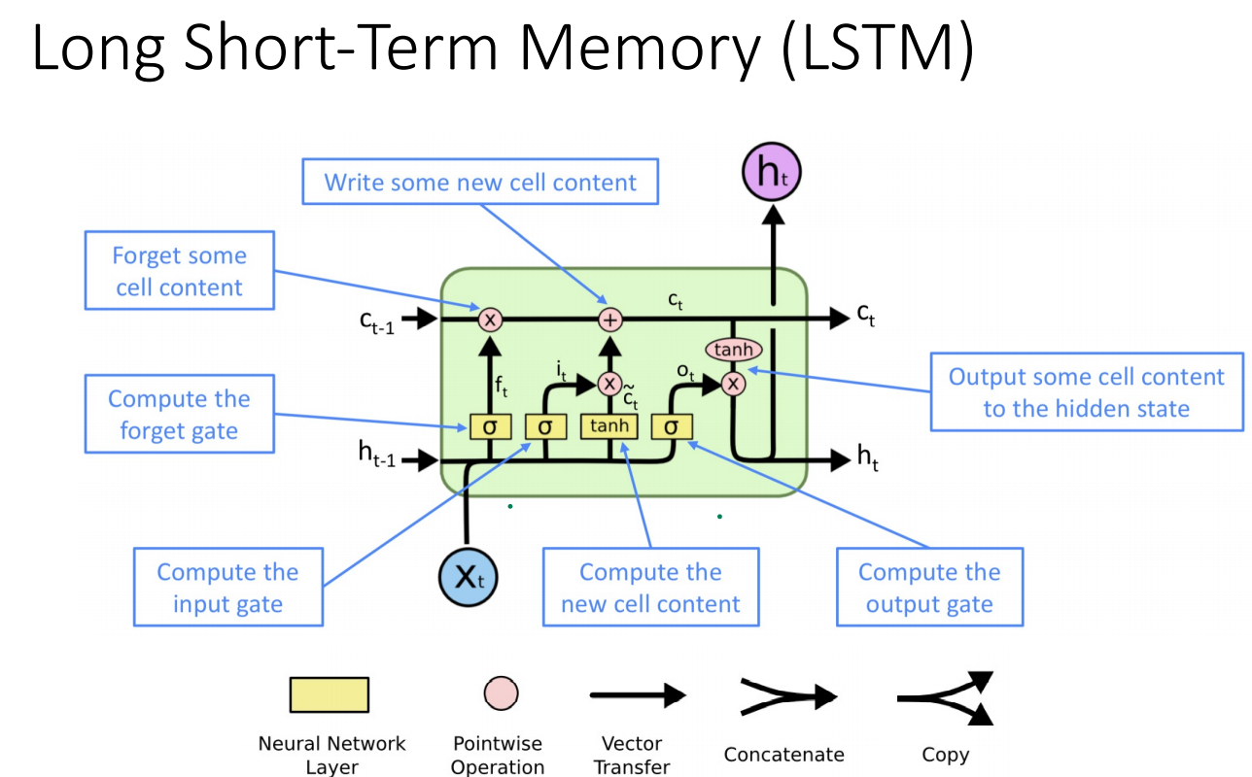
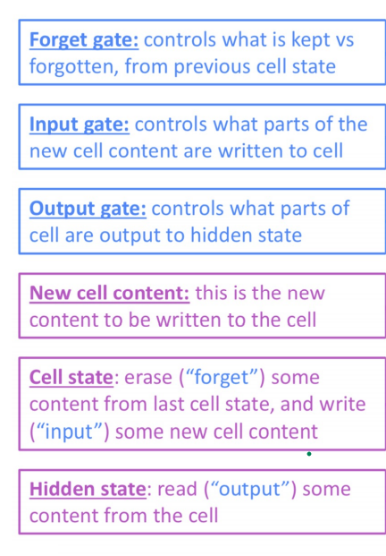
Data modeling - Deep learning techniques

Slide 51
Data modeling - Artificial Neural Network
Model architecture
One input layer, one hidden with 96 neurons and one output
Activation function : Rectified Linear function (ReLU)
Optimizer : ADAM
Loss function : Mean square error (MSE)
Simple model without covariate

Slide 52
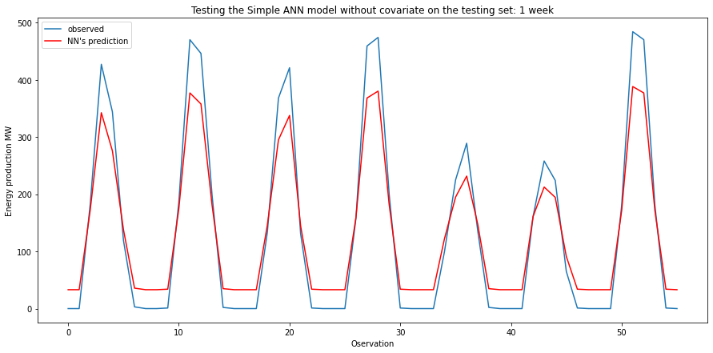
Data modeling - Artificial Neural Network
Results obtained for one week forecasting
Error | Value
RMSE | 45.6
R2 | 0.92
MAE | 38.1

Slide 53
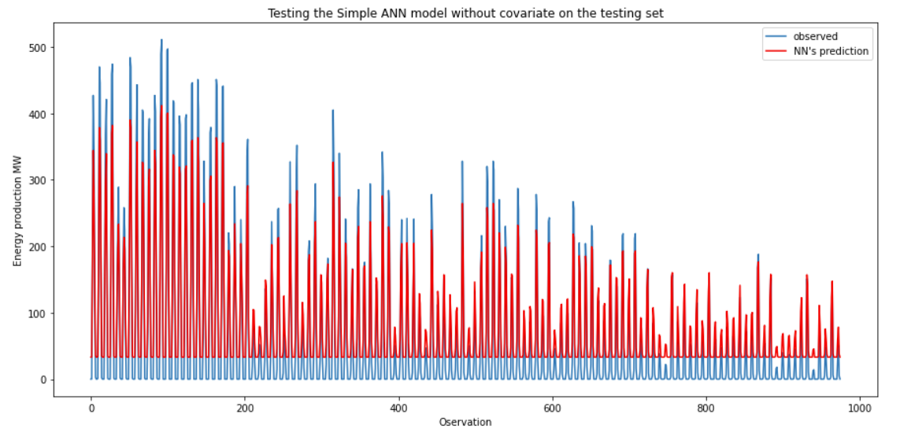
Data modeling - Artificial Neural Network
Comparison with testing set
Error | Value
RMSE | 35.4
R2 | 0.89
MAE | 32.6

Slide 54
Data modeling - Long Short Term Memory
Model architecture
One input layer, one hidden layer with 96 LSTM neurons
The output layer performs single-value prediction
Activation function : ReLU
Training time : 100 cycles
Each time 96 sample used for training
Without covariate

Slide 55
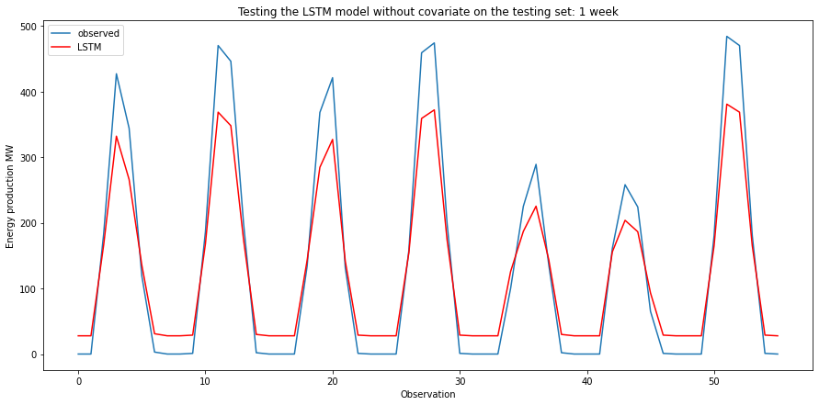
Long Short Term Memory without covariates
Results obtained for a one week forecasting
Error | Value
RMSE | 47.8
R2 | 0.92
MAE | 38.4

Slide 56
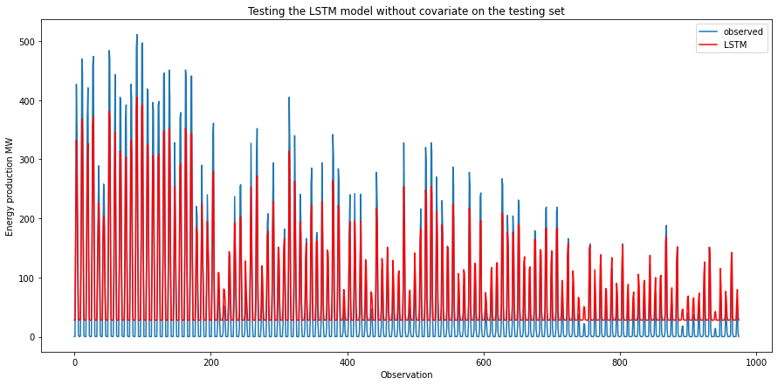
Long Short Term Memory without covariates
Comparison with testing set
Error | Value
RMSE | 34.5
R2 | 0.89
MAE | 30.5

Slide 57
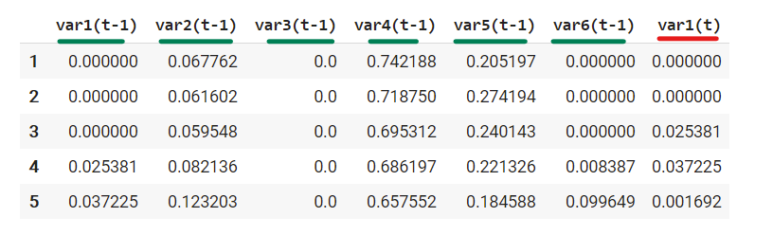
Data modeling - Long Short Term Memory
To further improve the quality of the model, covariates have been added to the input data using the same LSTM architecture
We can see the 6 input variables (input series) and the 1 output variable:

Slide 58
Data modeling - Long Short Term Memory
Model architecture
The input shape is one time step with 6 features
One hidden layer with 96 LSTM neurons
The output layer performs single-value prediction
Activation function : ReLU
Loss function: Mean Absolute Error; Optimizer: Adam
Training time : 100 cycles
Batch size used with 96 samples.

Slide 59
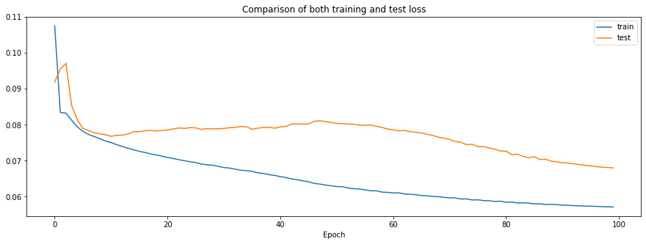
Data modeling - Long Short Term Memory
Loss functions of both training set and testing set:

Slide 60
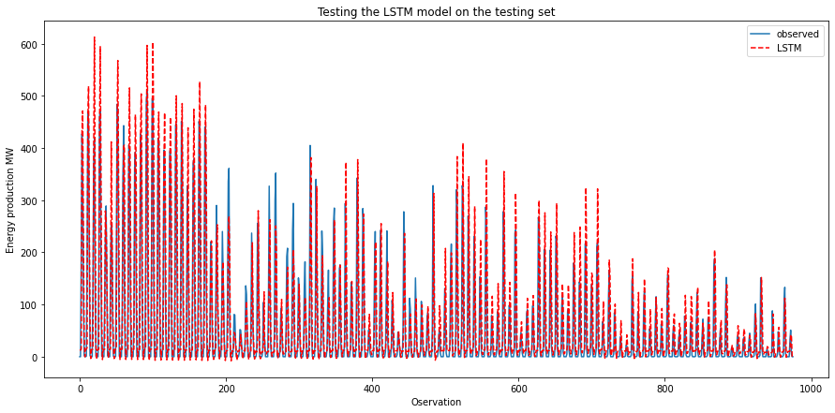
Long Short Term Memory with covariates
Comparison with testing set

Slide 61
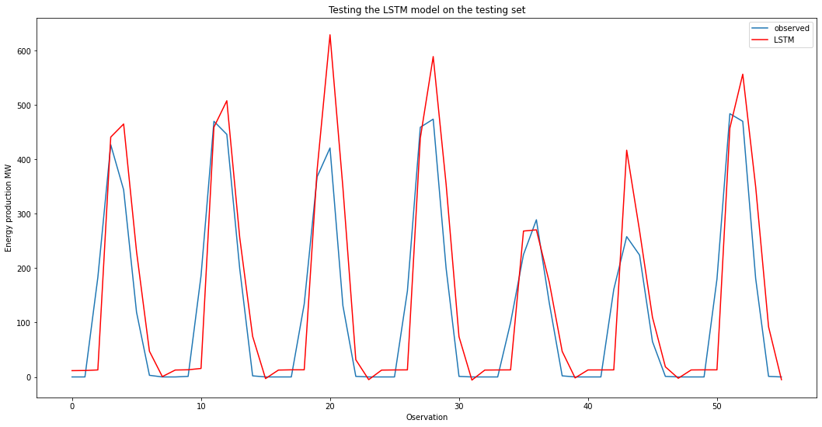
Long Short Term Memory with covariates
Results obtained for a one week forecasting
Error | Value
RMSE | 66.2
R2 | 0.6
MAE | 40.2

Slide 62
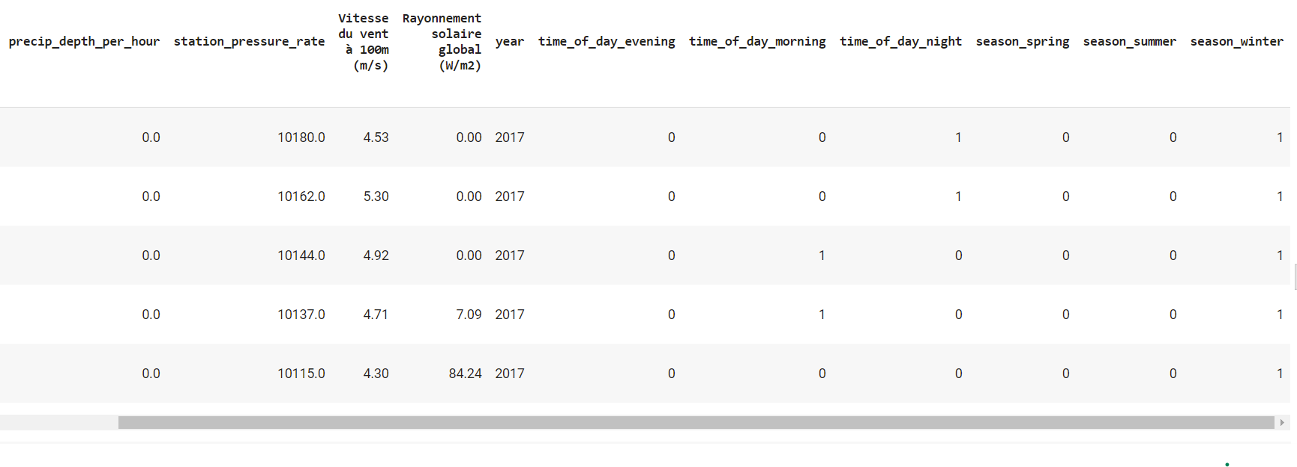
Long Short Term Memory in reduced feature space
Like in the lasso regression, a season feature have been introduced to capture the month/hour specificity (winter/summer…, night/morning…) for feature space reduction

Slide 63
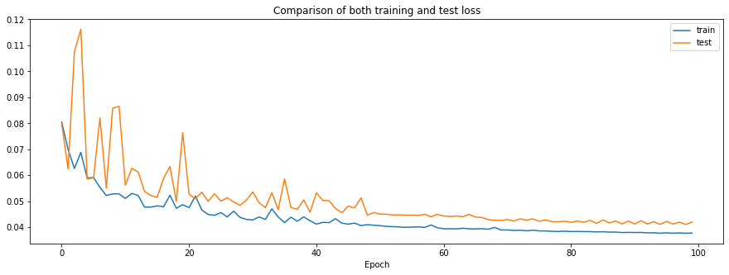
Long Short Term Memory in reduced feature space
Loss functions of both training set and testing set

Slide 64
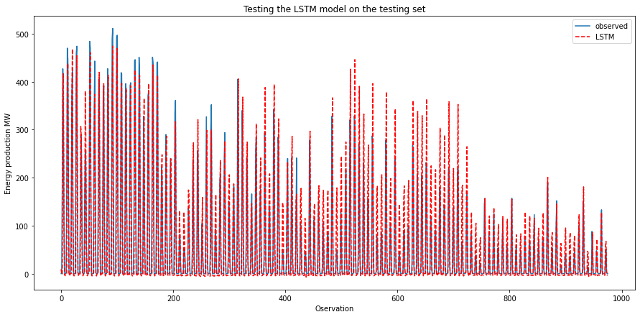
Long Short Term Memory in reduced feature space
Comparison with testing set

Slide 65
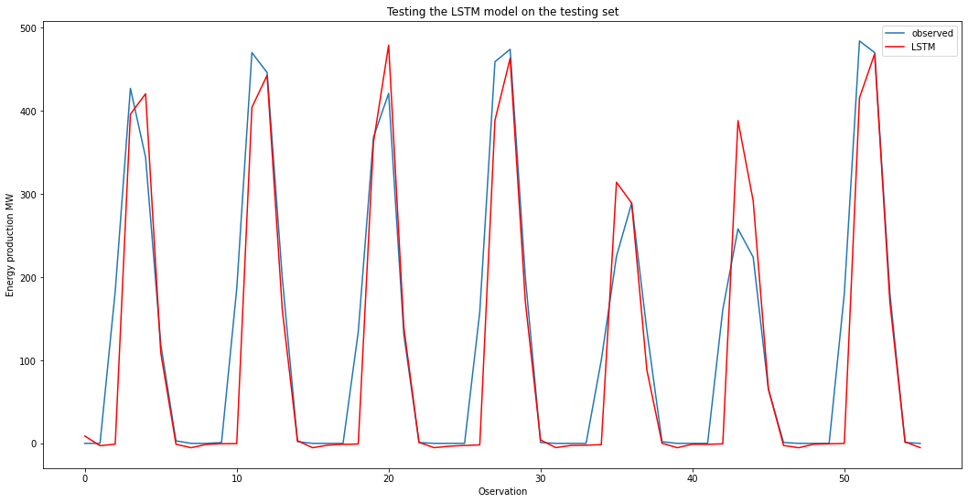
Long Short Term Memory in reduced feature space
Results obtained for a one week forecasting
Error | Value
RMSE | 46.2
R2 | 0.8
MAE | 24.8

Slide 66
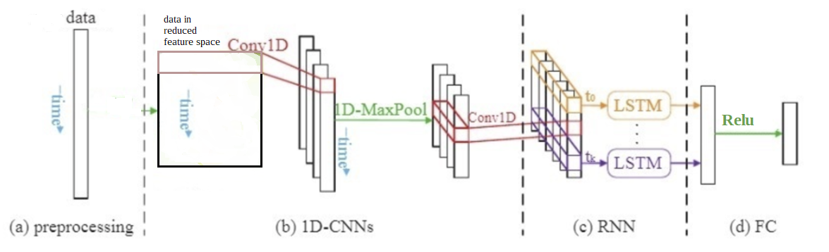
Hybrid CNN-LSTM Network in reduced feature space
Overall architecture of the proposed method:

Slide 67
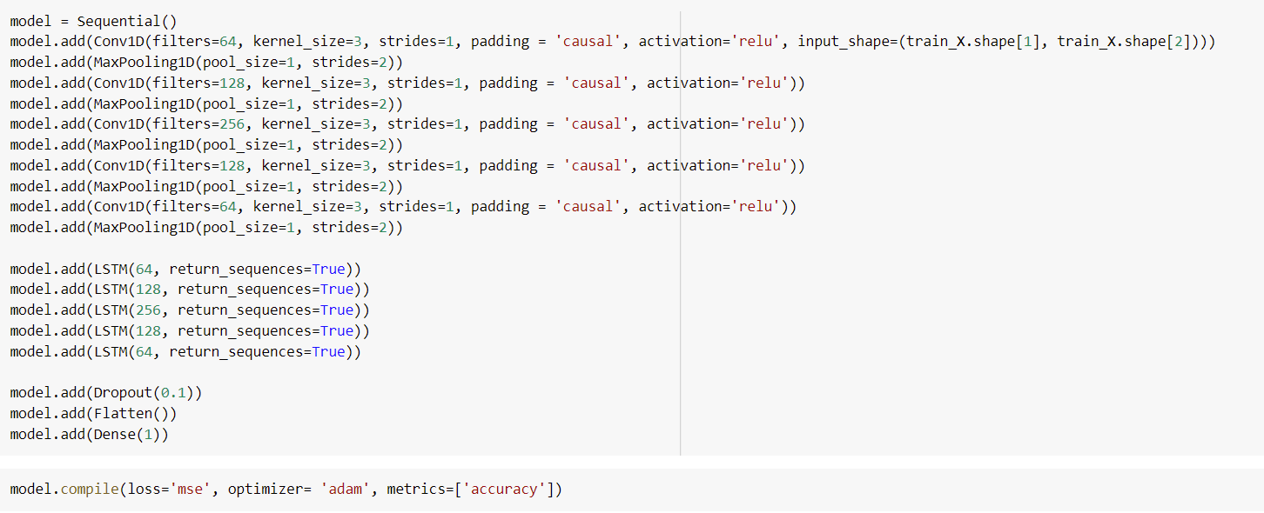
Hybrid CNN + LSTM Network in reduced feature space

Slide 68
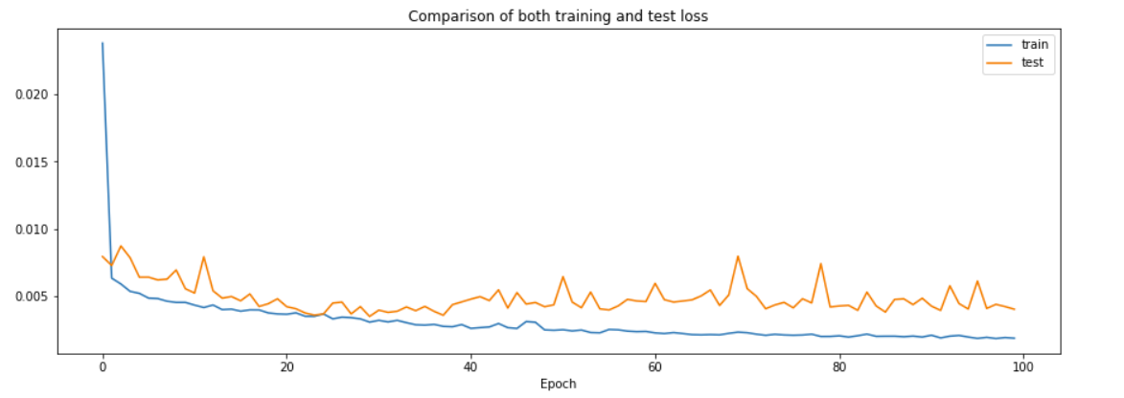
CNN + LSTM Network in reduced feature space
Loss functions of both training set and testing set

Slide 69
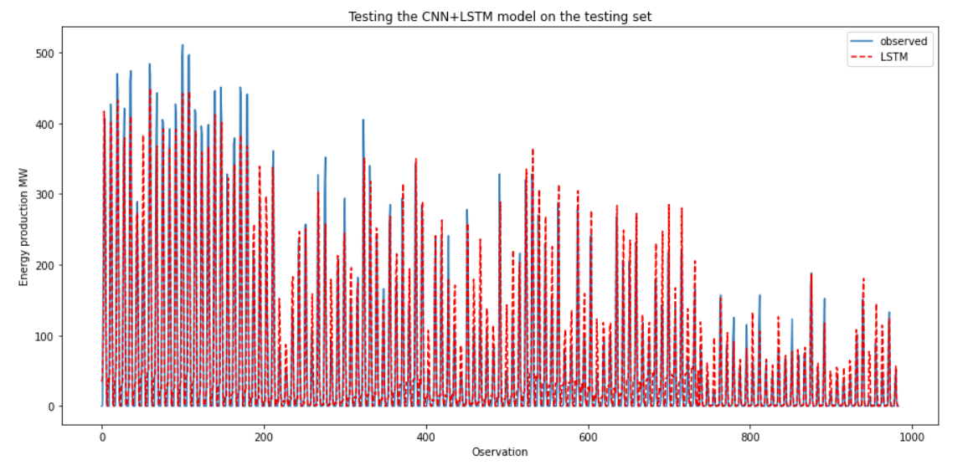
CNN + LSTM Network in reduced feature space

Slide 70
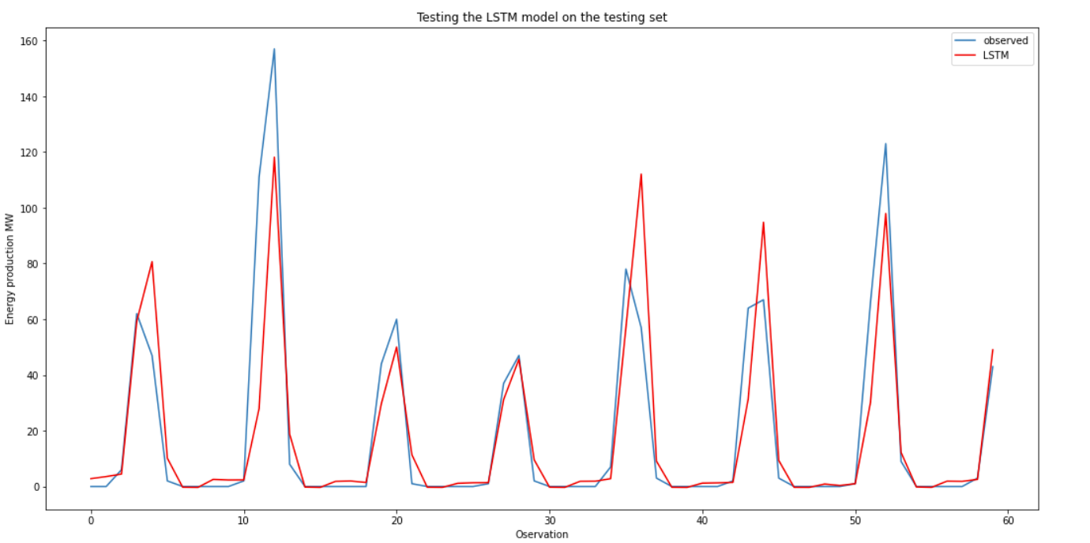
CNN + LSTM Network in reduced feature space
Results obtained for a one week forecasting
Error | Value
RMSE | 39.06
R2 | 0.87
MAE | 23.79

Slide 71
Summary table
Models | RMSE | R2 | MAE
FBProphet | 60.4 | 0.70 | 47.3
SARIMAX + Fourier | 60.0 | 0.87 | 47.6
Lasso regression | 69.5 | 0.82 | 52.0
Elastic Net regression | 83.2 | 0.74 | 60.6
Random Forest regression | 56.3 | 0.88 | 34.7
XGBoost | 47.3 | 0.92 | 30.8
ANN | 45.6 | 0.92 | 38.1
LSTM without covariates | 47.8 | 0.92 | 38.4
LSTM with covariates in reduced feature space | 46.2 | 0.8 | 24.8
CNN + LSTM with covariates in reduced feature space | 39.06 | 0.87 | 23.79

Slide 72
Project framework
Project definition
Data mining and processing
Data exploration
Data modeling
Evaluation and prediction
1
2
3
4
5

Slide 73
Forecasting results using the best model
Best model chosen : CNN + LSTM with covariates in reduced feature space

Slide 74

Challenges & Next steps
Find open source weather & solar radiance forecast data, evaluate and incorporate them for solar energy prediction
Experiment other models (CNN/Transformer), as well as combination of models and to compensate for the limitations
Creation of an API and graphical user interface
Dynamic update of data for continuous modeling and forecasting

Slide 75
Thank you!
Q&A

